Slide 1
Clustering Using Amazon SageMaker FINAL PRESENTATION
PRESENTED BY Group-10: PRANAY BHAKTULA
RAKSHITH REDDY ELETI

Slide 2



AWS RESOURCES
Identity Access Management(IAM)
Simple Storage Service(S3)
Amazon SageMaker

Slide 3


Project Architecture
Data
S3 Bucket
Sagemaker
Juypter notebook
Deploy ML models
Results

Slide 4
What is an Amazon SageMaker?
Amazon SageMaker is a fully managed service that allows any developer or data scientist to swiftly create, train, and deploy machine learning (ML) models.
Amazon SageMaker includes modules that can be used together or independently to build, train, and deploy your machine learning models.
A free service that gives customers access to AWS compute resources in an environment based on open-source JupyterLab.

Slide 5

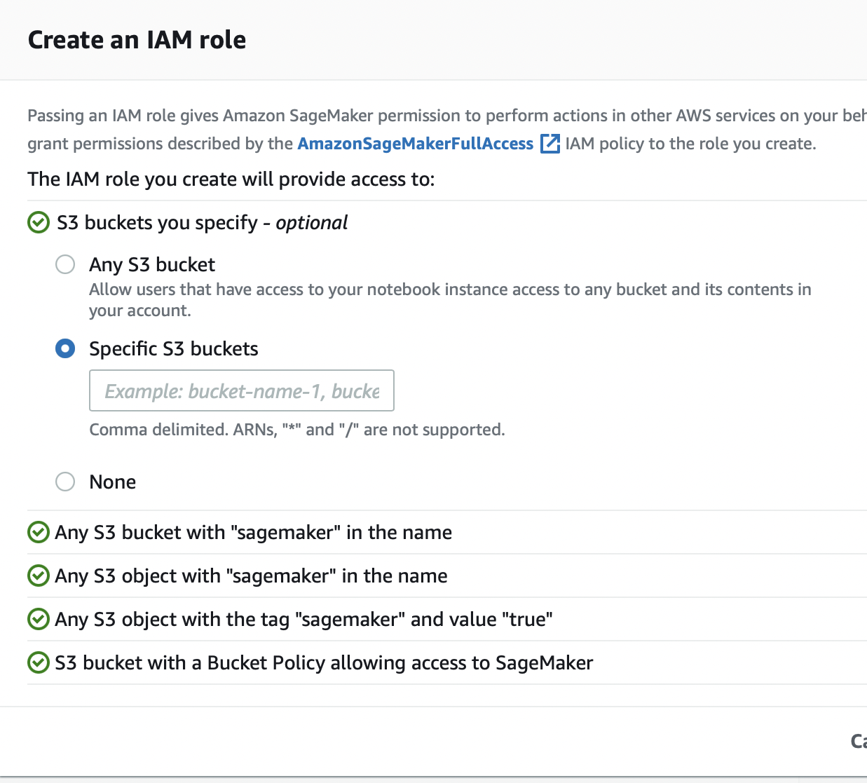
In the Amazon Sagemaker navigation pane, choose Amazon SageMaker Studio.
If this is your first time using Amazon SageMaker Studio, you must go through the onboarding procedure. You can utilize AWS Single Sign-On (AWS SSO) or AWS Identity and Access Management (IAM) for authentication methods during onboarding. You can utilize either the Quick start or the Standard

Slide 6
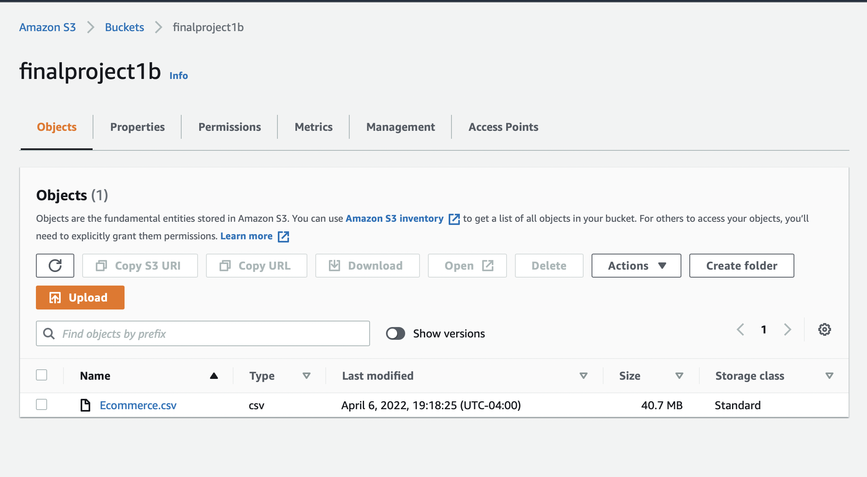
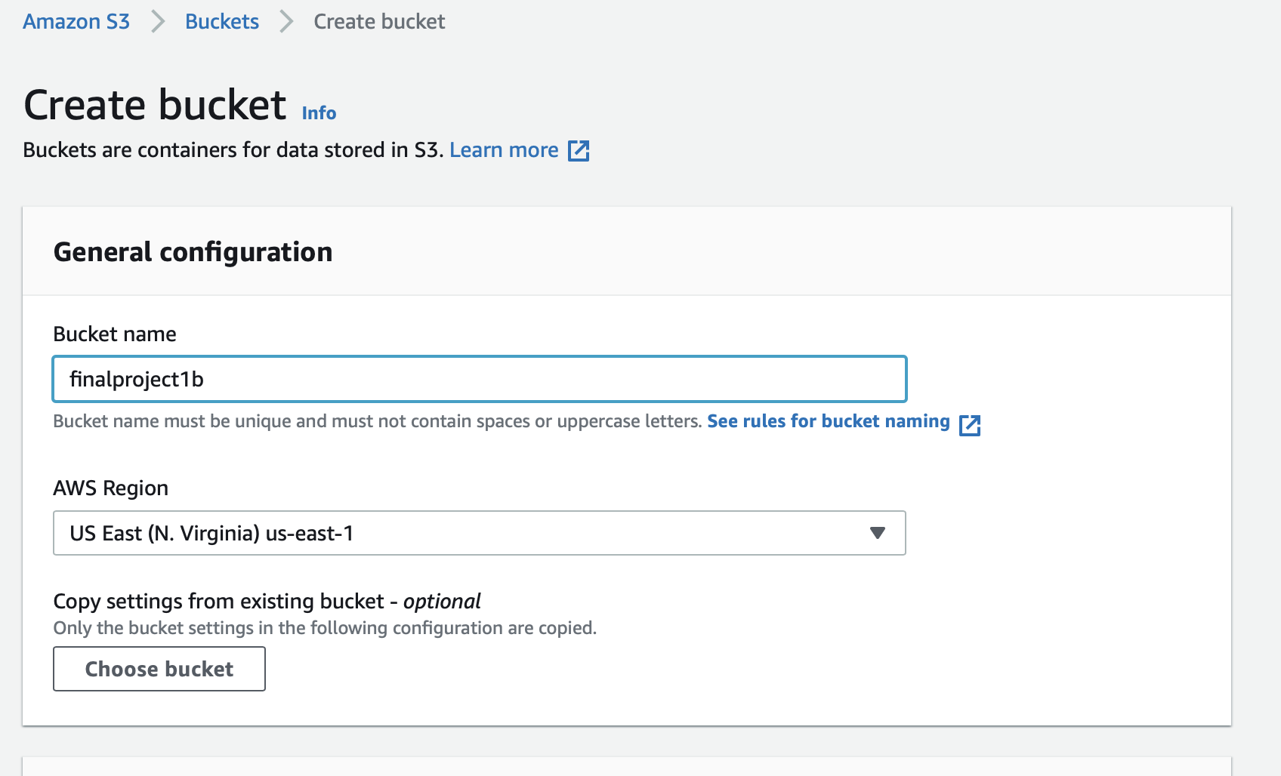
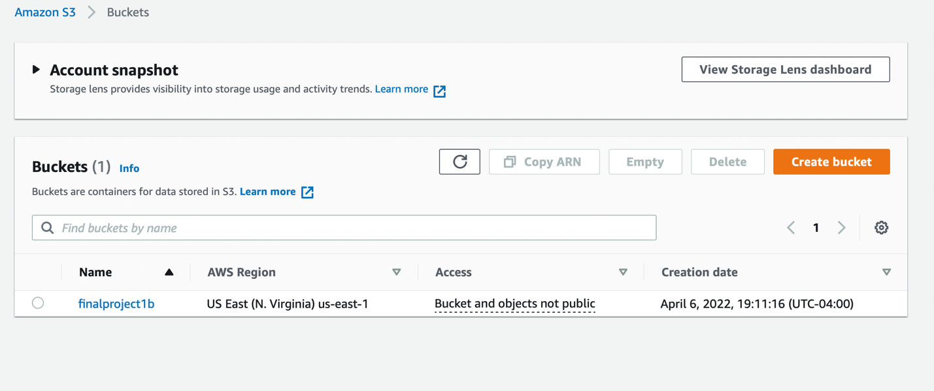

Slide 7
DATASET DESCRIPTION
The dataset we are using is the High Value Customer Identification based on an online retail store in UK.
A UK-based online retail store has captured the sales data for different products for the period of one year (Nov 2016 to Dec 2017) and updated the dataset (in 2020).
The organization sells gifts primarily on the online platform. The customers who make a purchase, consume directly for themselves.
There are small businesses that buy in bulk and sell to other customers through the retail outlet channel.
This is a trans-national dataset that contains all the transactions occurring between Nov-2016 to Dec-2017 for a UK-based online retail store.
The project objective is to find significant customers for the business who make high purchases of their favorite products.
The organization wants to roll out a loyalty program to high-value customers after the identification of segments.

Slide 8
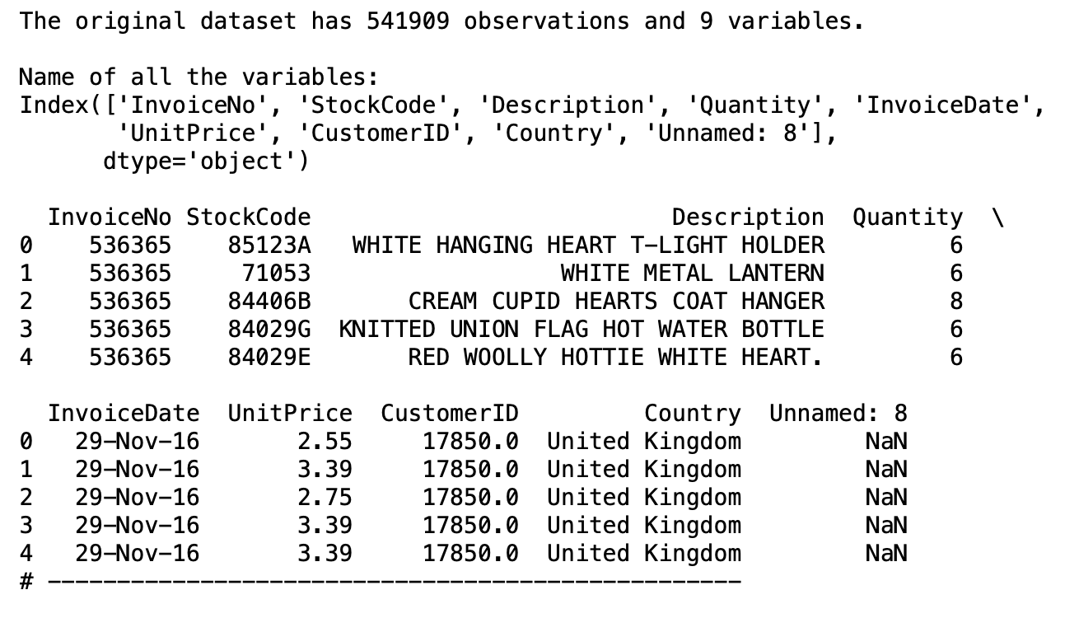
InvoiceNo: Invoice number (A 6-digit integral number uniquely assigned to each transaction)
StockCode: Product (item) code
Description: Product (item) name
Quantity: The quantities of each product (item) per transaction
InvoiceDate: The day when each transaction was generated
UnitPrice: Unit price (Product price per unit)
CustomerID: Customer number (Unique ID assigned to each customer)
Country: Country name (The name of the country where each customer resides)

Slide 9
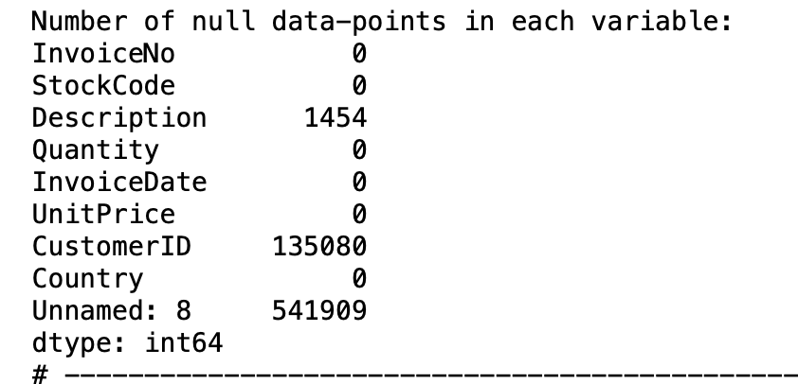
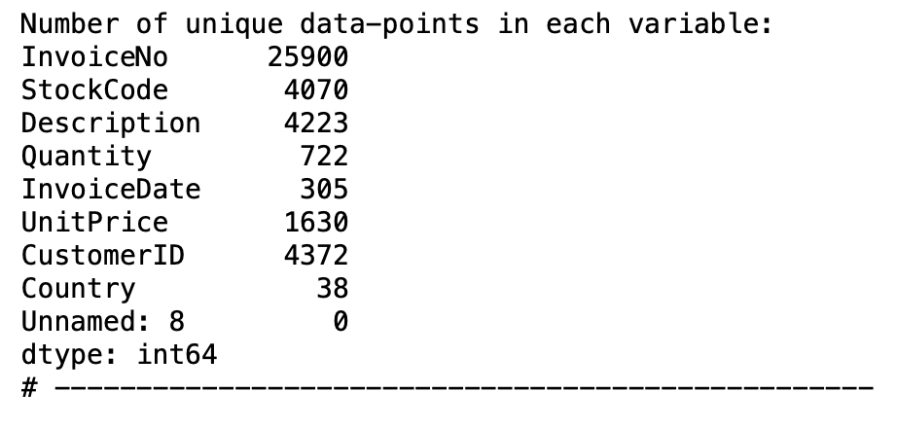

Slide 10
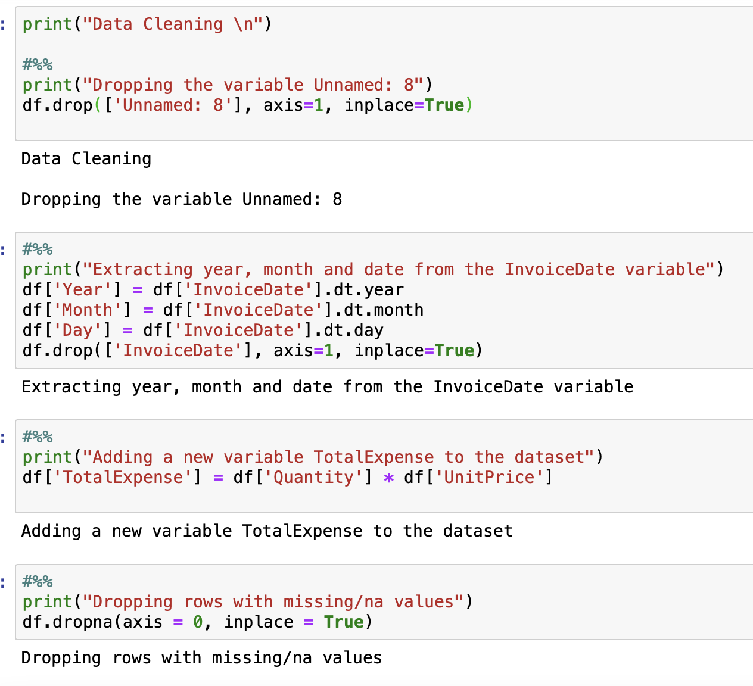
DATA CLEANING
We continue with Checking for data cleansing, deleting the unnamed Feature because we don't need it.
After that, we created a new variable Total Expense by multiplying quantity and unit price.
After that, we remove any missing data.
Then we go over the list to see if there are any duplicates.

Slide 11
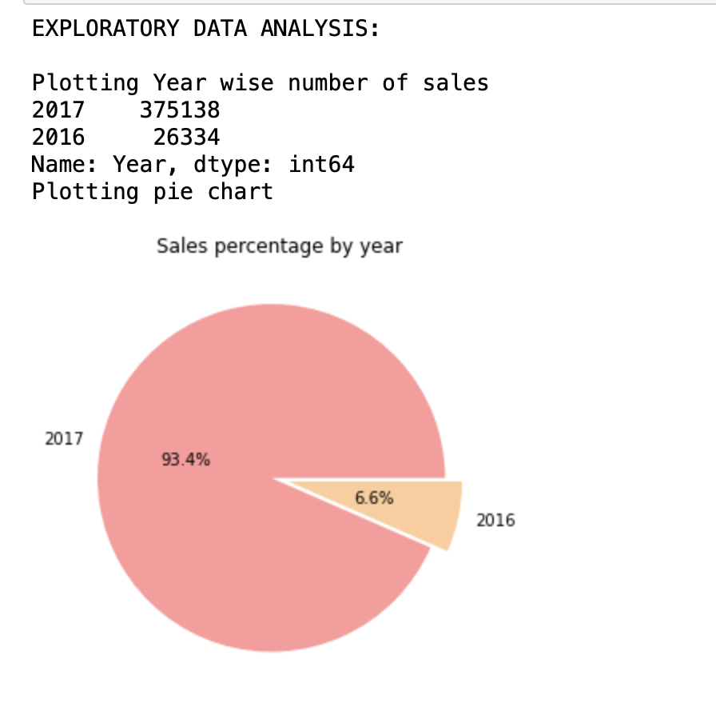
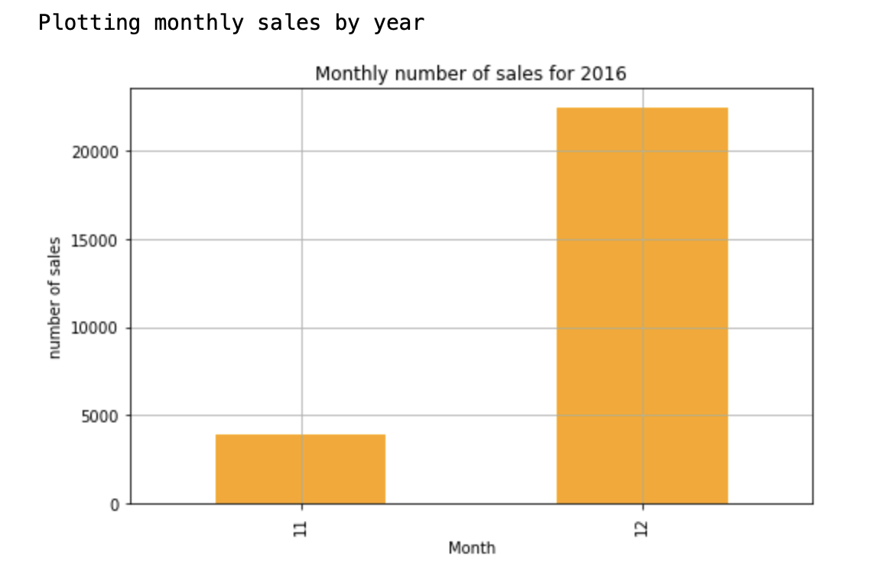
EXPLORATORY DATA ANALYSIS

Slide 12
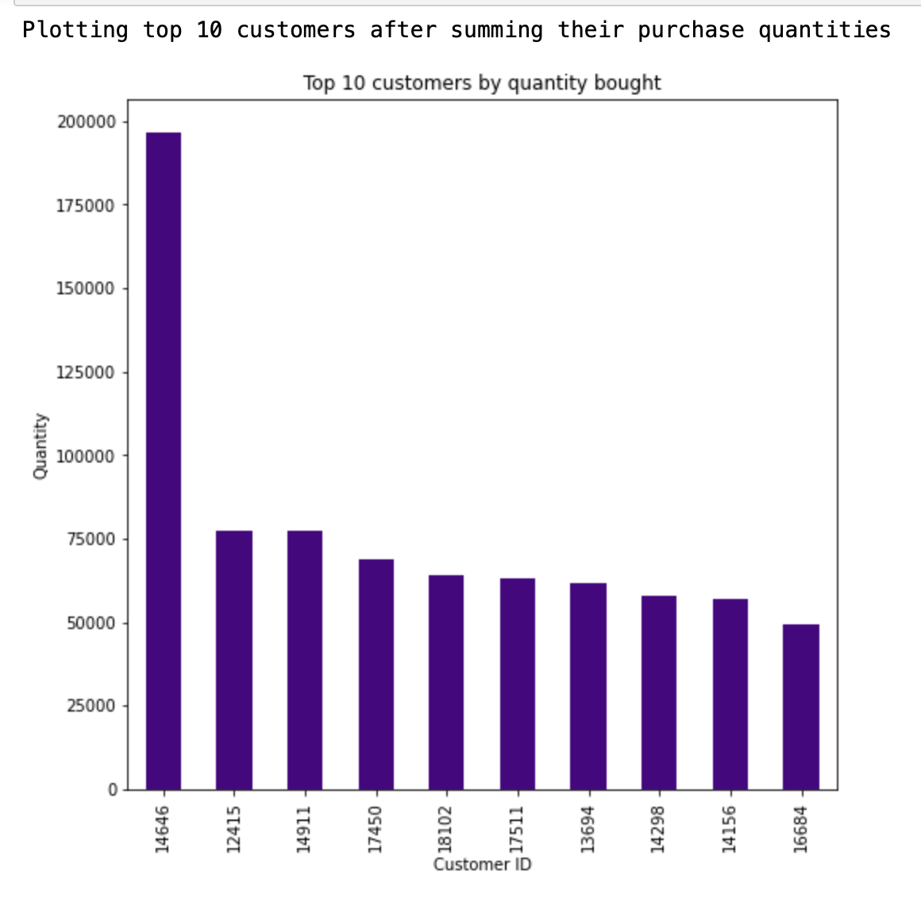
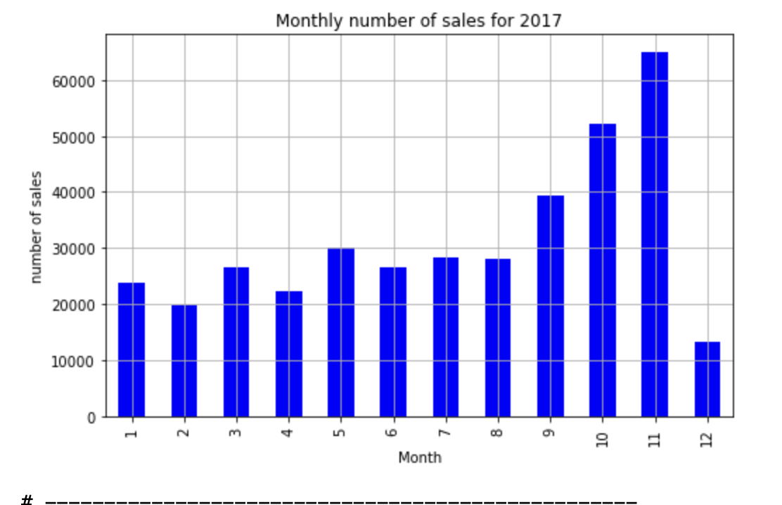

Slide 13
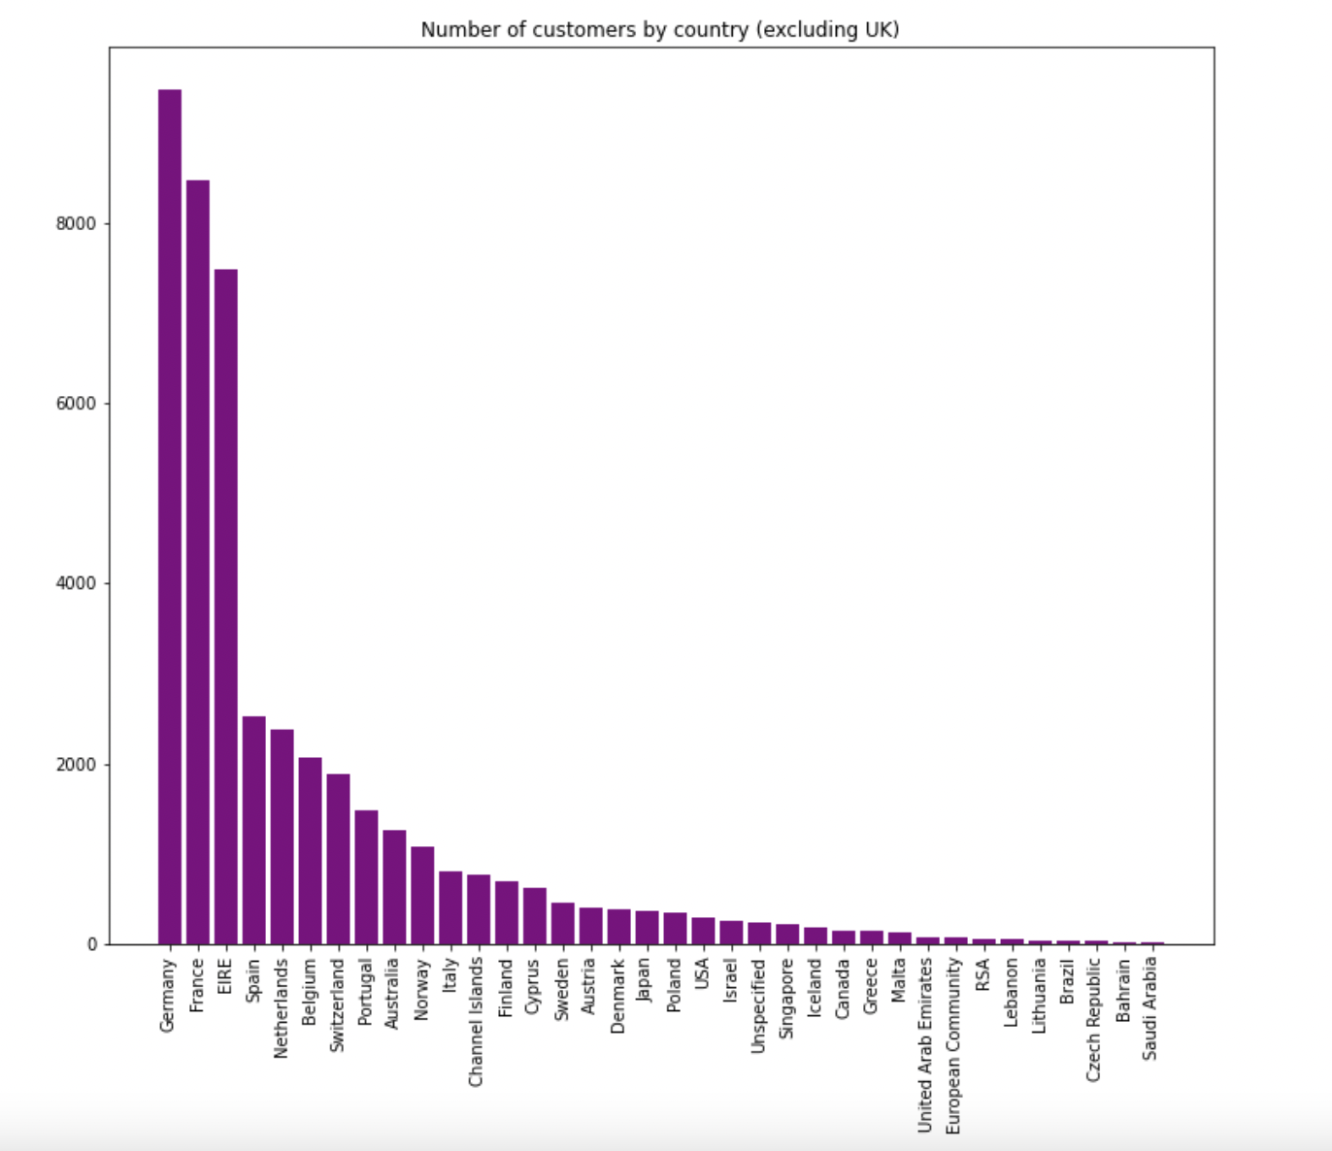

Slide 14
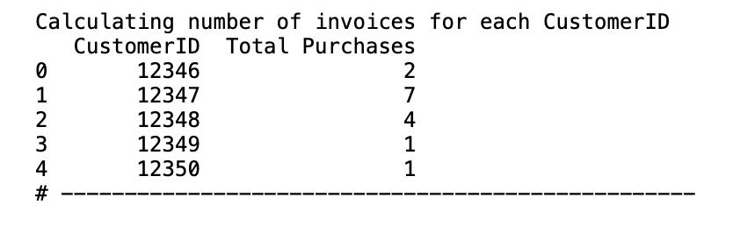
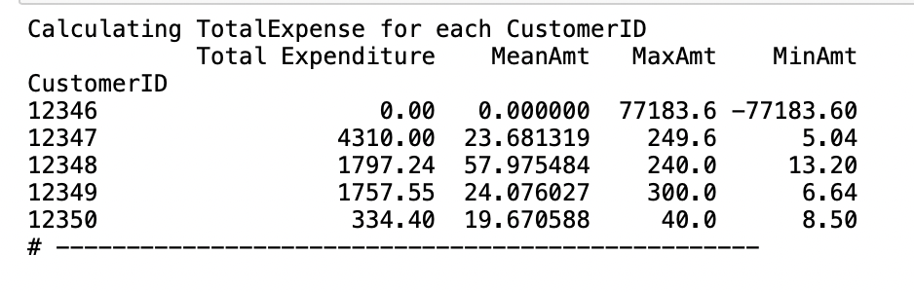
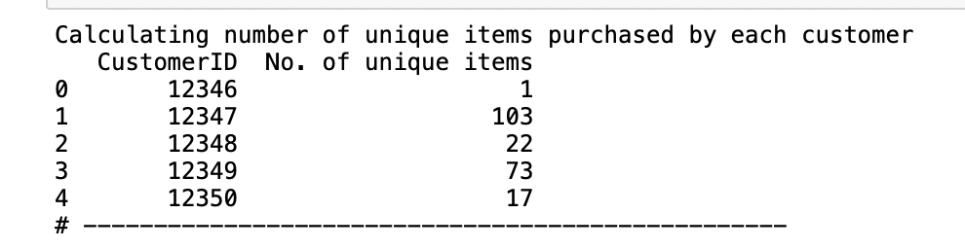

Slide 15
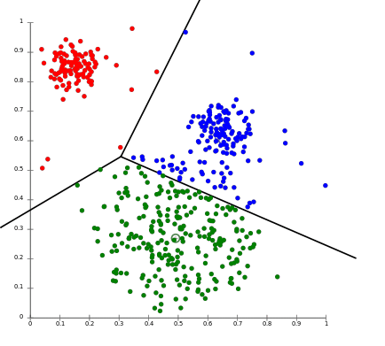
K-MEANS CLUSTERING
To process the learning data, the K-means algorithm in data mining starts with a first group of randomly selected centroids, which are used as the beginning points for every cluster, and then performs iterative (repetitive) calculations to optimize the positions of the centroids
It halts creating and optimizing clusters when either:
The centroids have stabilized — there is no change in their values because the clustering has been successful.
The defined number of iterations has been achieved.

Slide 16
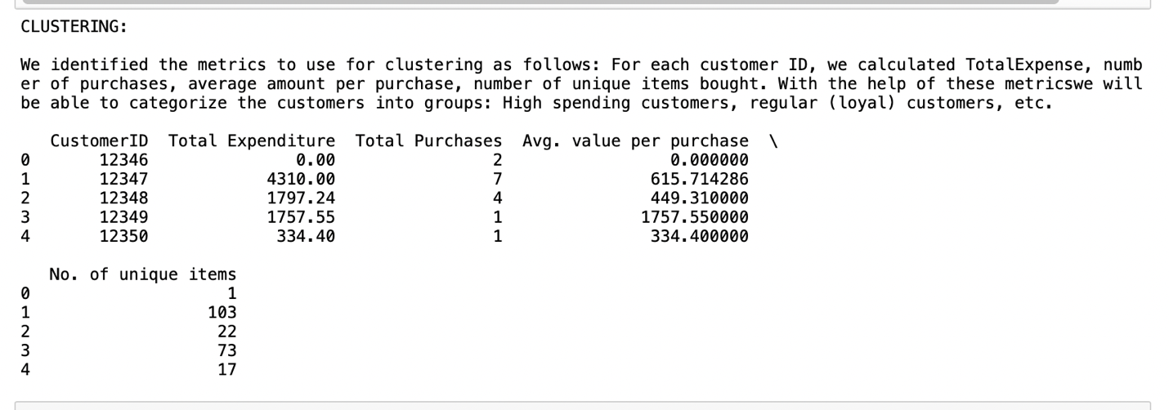
CLUSTERING

Slide 17
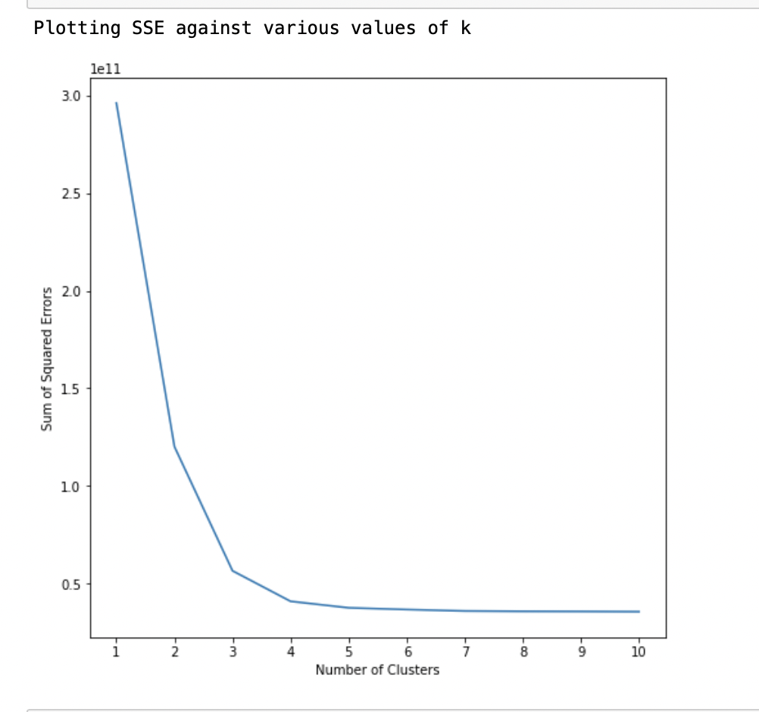
ELBOW METHOD
The elbow method runs k-means clustering on the dataset for a range of values for k (say from 1-10) and then for each value of k computes an average score for all clusters. By default, the distortion score is computed, the sum of square distances from each point to its assigned center
Here, from the graph we can see that k = 4.

Slide 18
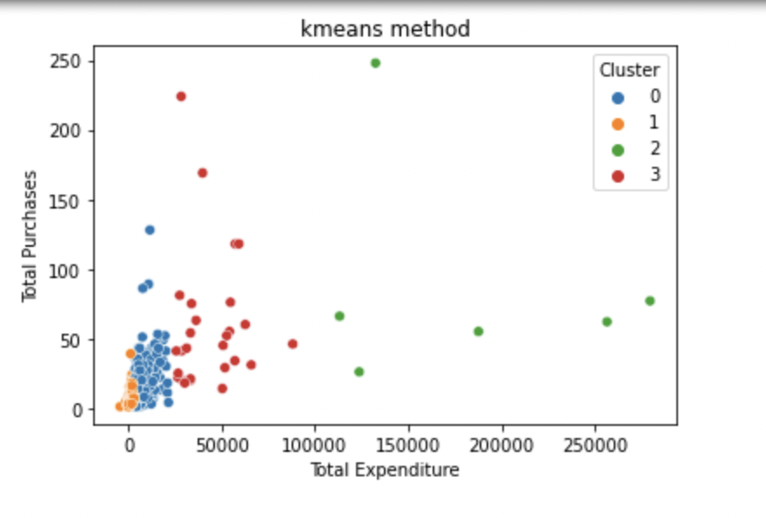
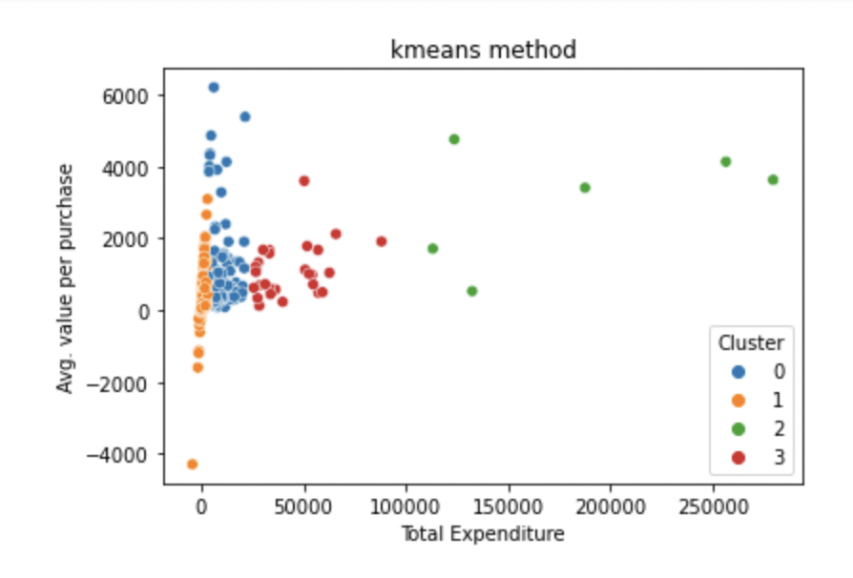

Slide 19
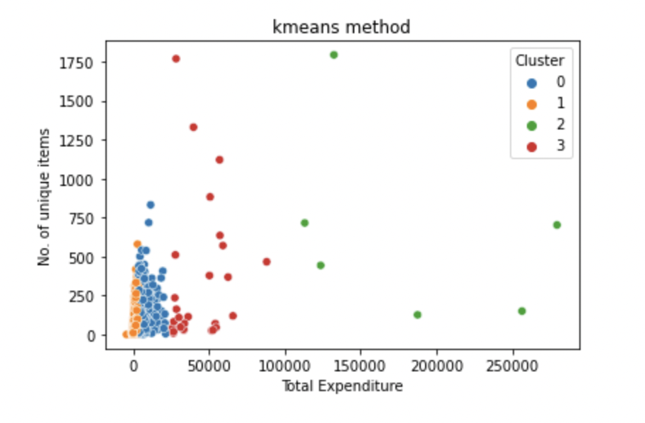
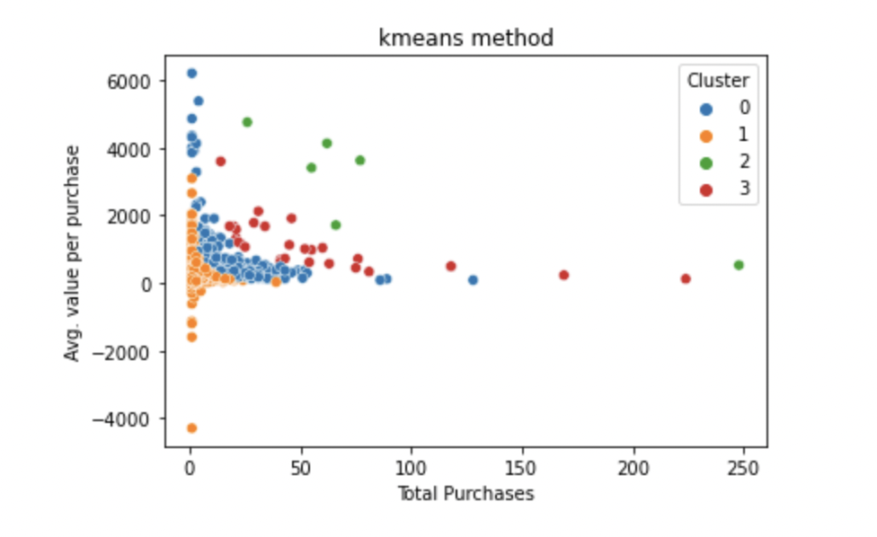

Slide 20
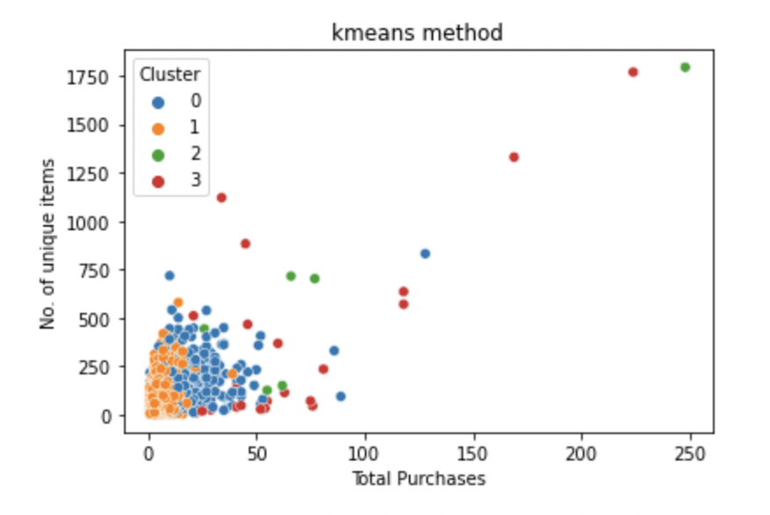
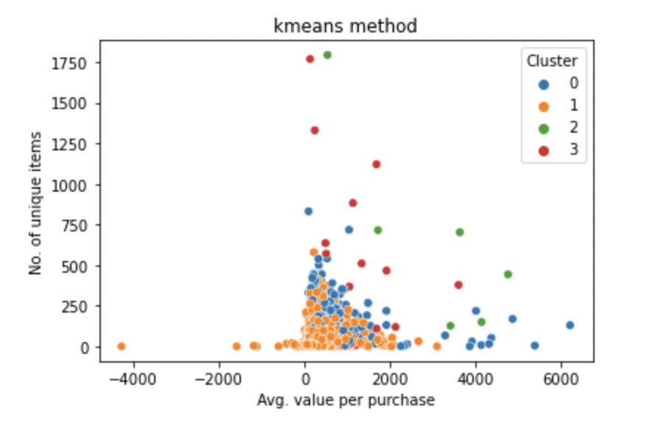

Slide 21
We may draw a few conclusions and attribute certain features to the clusters based on the scatter plots exhibiting distinct groups.
Cluster 0: The expenditure amount is moderate, make the moderate purchases, and buy the highest number of unique goods.
Cluster 1: Has the lowest expenditure. The total purchases is also less. These consumers have purchased a huge quantity of unique goods.
Cluster 2: Total expenditure is highest and total number of purchases is very less..
Cluster 3: Total expenditure is moderate-high and total number of purchases is high

Slide 22
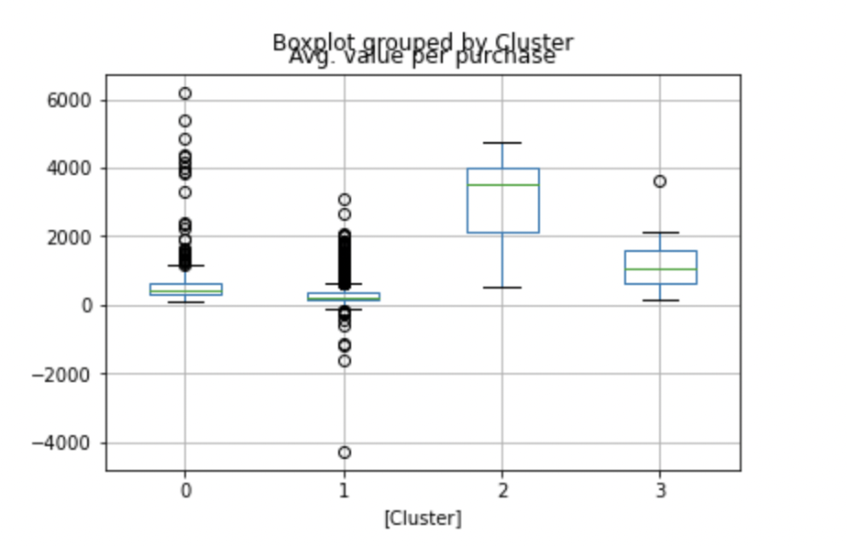
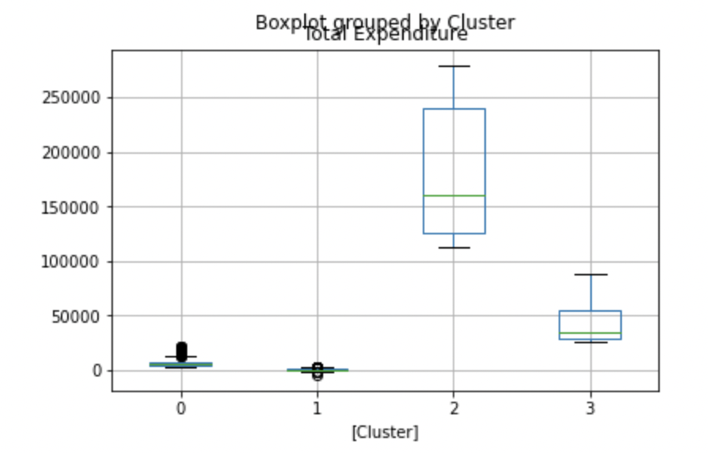
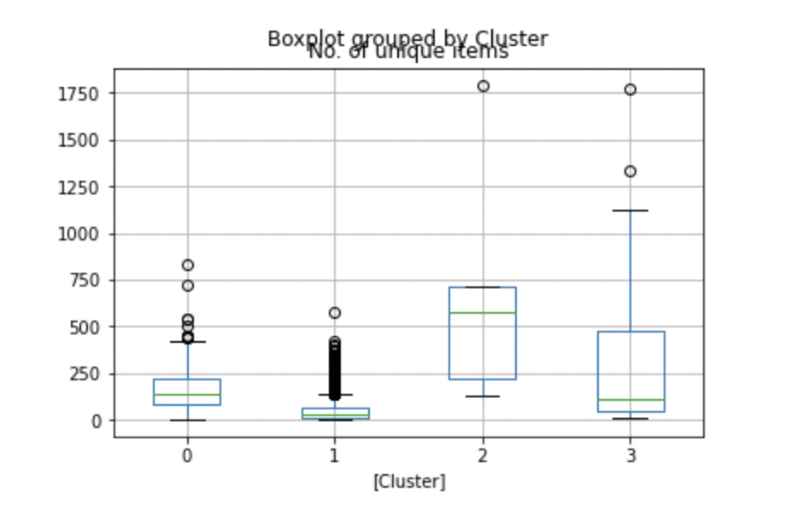
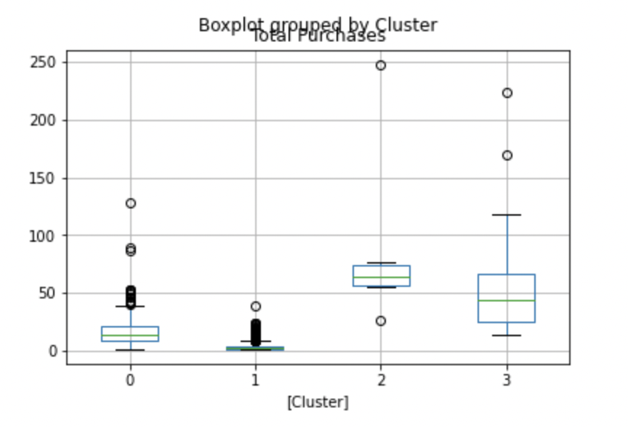

Slide 23
To corroborate our findings from the scatter plots, we created boxplots.
These clusters can be classified as follows based on our observations:
In order to raise their purchase numbers, Clusters 1 and 2 need to be given greater attention in terms of discounts and other incentives.
Cluster 3 might be thought of as high-value clients who should be rewarded with a loyalty program. These clients are also loyal, as seen by the amount of transactions they have made.
Cluster 0 is also made up of high-value yet loyal consumers that frequent the shop.

Slide 24
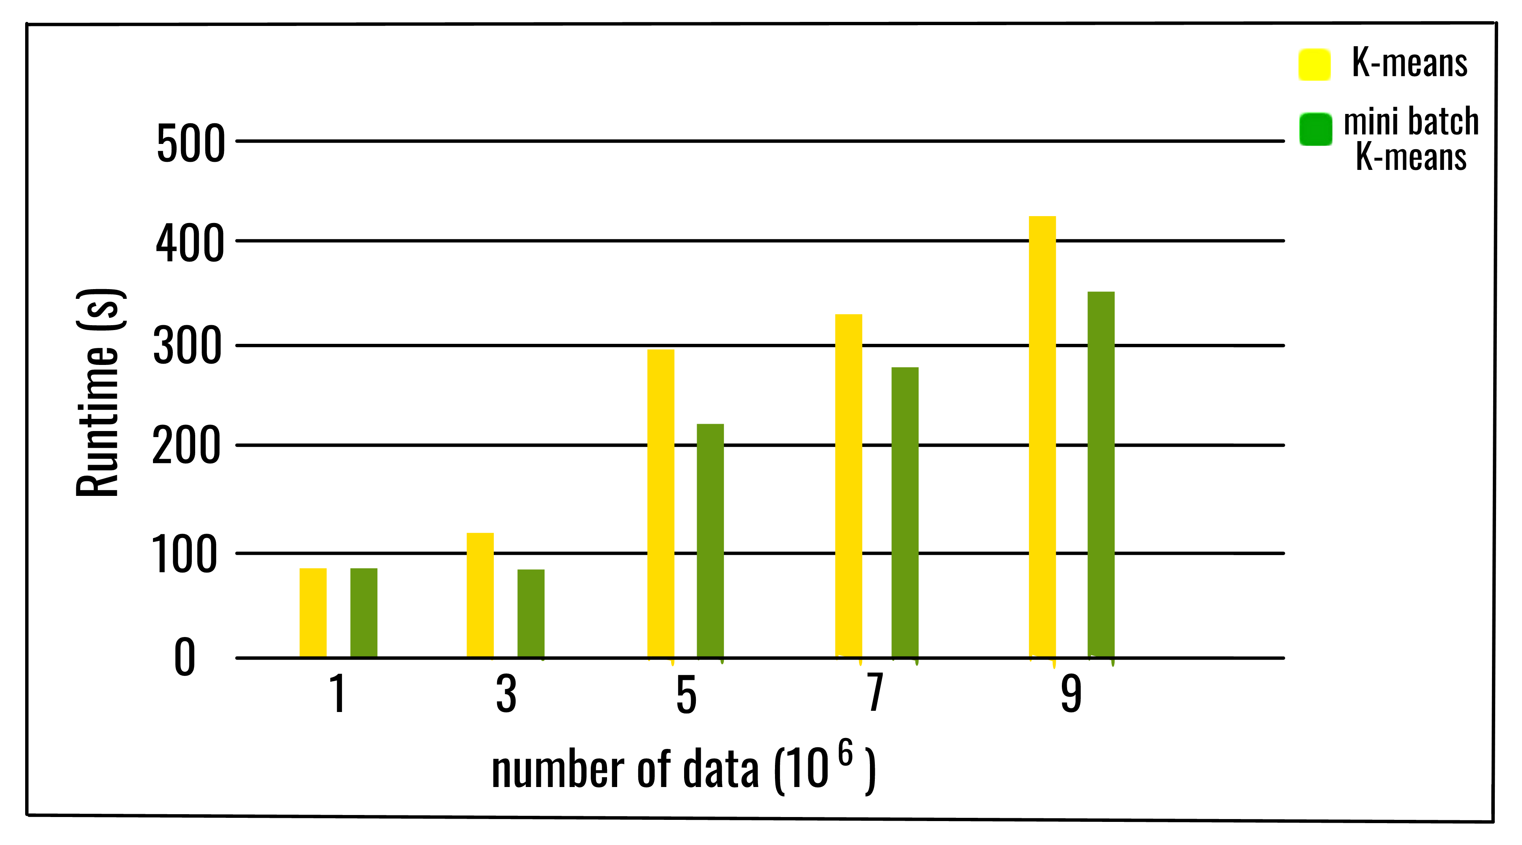
MINIBATCH K-MEANS CLUSTERING
The primary idea behind the Mini Batch K-means method is to employ tiny random batches of data with a fixed size so that they may be kept in memory. Each iteration obtains a fresh random sample from the dataset and uses it to update the clusters, and the process is continued until convergence.
The mini-batch k-means algorithm operates in the same way as the k-means algorithm described in the previous recipe. Without getting into too much detail, the distinction is that the most computationally expensive step in mini-batch k-means is performed on only a random sample of data rather than all observations.

Slide 25
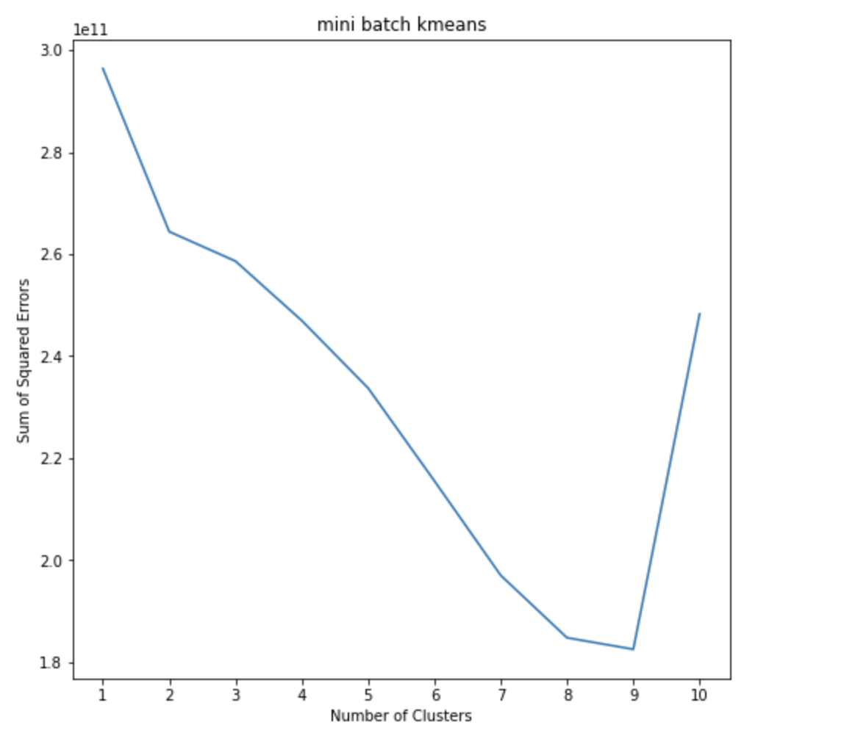
ELBOW METHOD FOR MINIBATCH K-MEANS

Slide 26
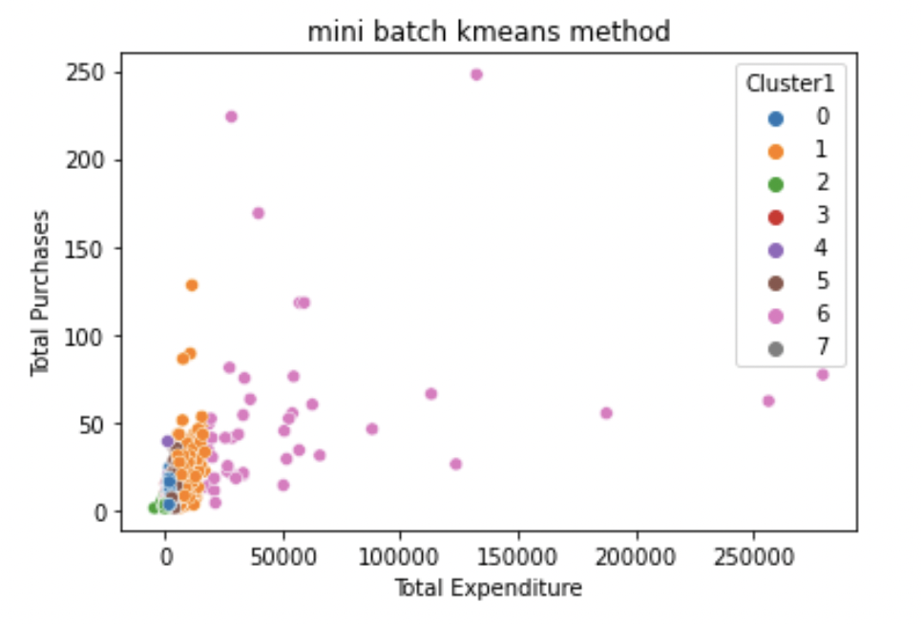
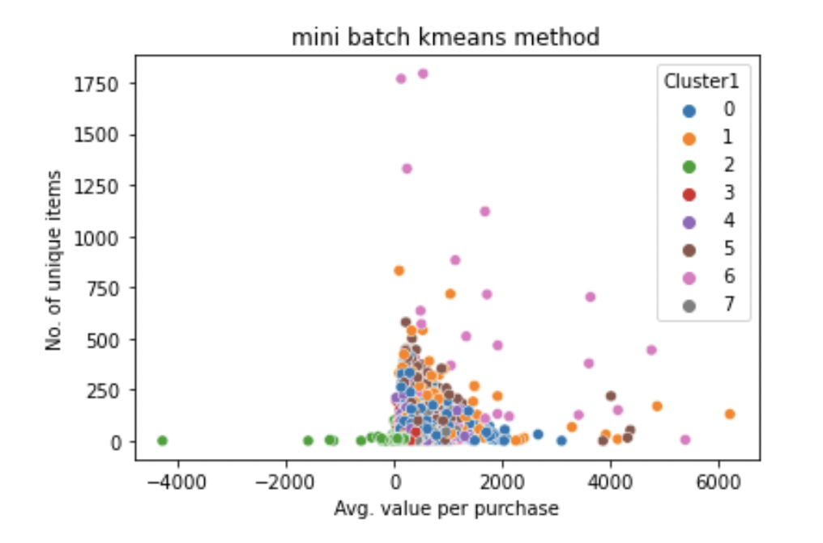

Slide 27
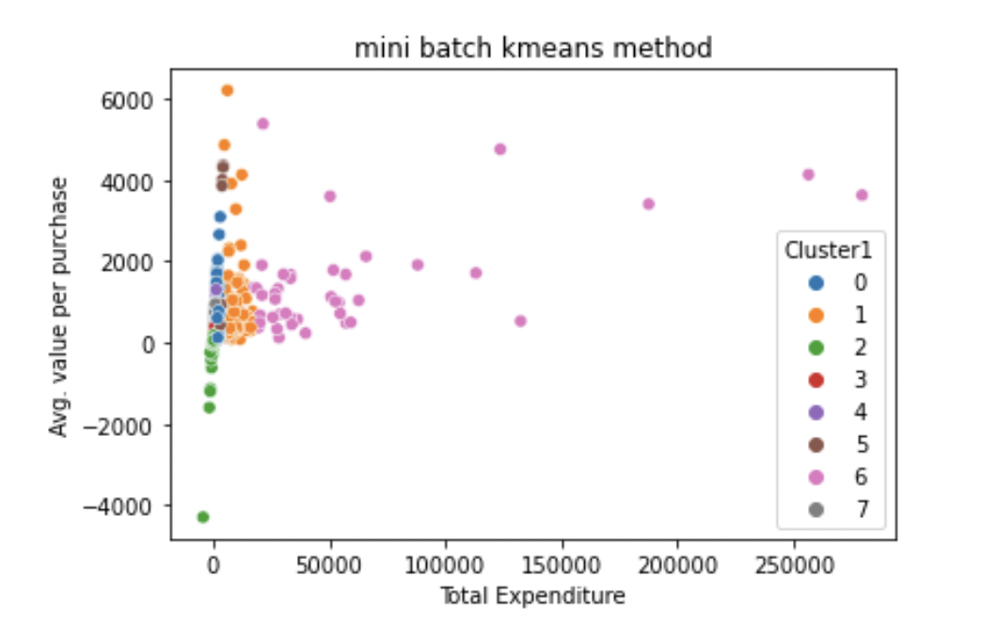
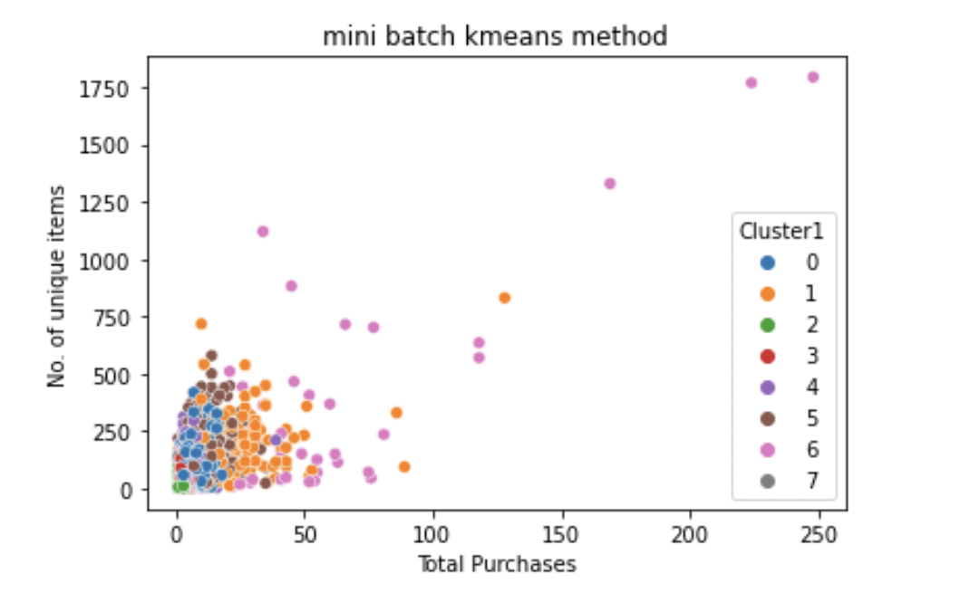
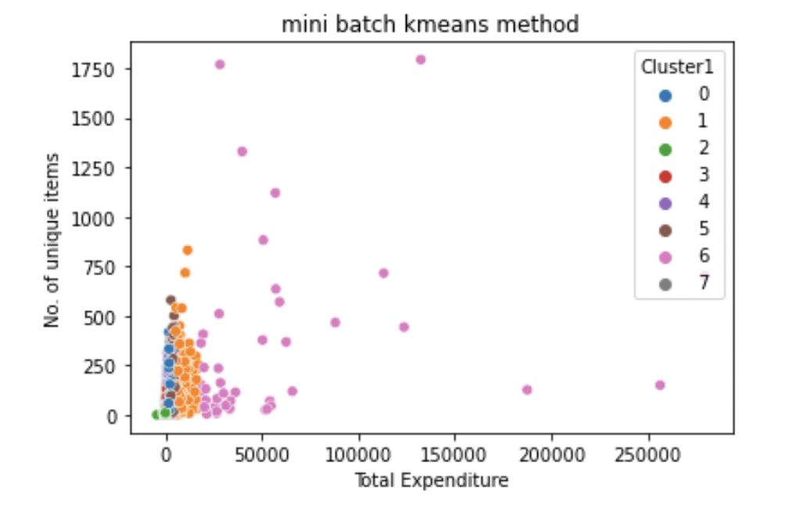

Slide 28
RESULTS
We may deduce from the kmeans results that Cluster 3 represents high-value clients for whom the firm should implement for the loyalty program.
After comparing the SSE of the K-Means and Mini-Batch K-Means algorithms, we chose the K-Means approach since it has a lower SSE than Mini-Batch K-Means.

Slide 29
References:
https://www.geekhttps://www.geeksforgeeks.org/ml-mini-batch-k-means-clustering-algorithm/ sforgeeks.org/ml-mini-batch-k-means-clustering-algorithm/
https://chrisalbon.com/code/machine_learning/clustering/minibatch_k-means_clustering/
https://aws.amazon.com/getting-started/hands-on/build-train-deploy-machine-learning-model-sagemaker/

Slide 30

THANK YOU

